Slide 1
Analyzing and Predicting Covid-19 Confirmed Cases in Pakistan
Farjad Suhail

Slide 2
Covid-19
First known case identified in China
The virus spread worldwide affecting
Economy, Businesses and Education
In Pakistan third wave has been deadlier than the previous two
So we decided to do our project on predicting the cases in the upcoming 10 days
Contagious disease causes by respiratory syndrome

Slide 3
Research Goal
Analyze current trends in each province of Pakistan
Calculate the infection rate and transmission rate
Forecast data to make better decisions in order to curtail the spread of virus.
Analyzing and Predicting Covid-19 Confirmed Cases in Pakistan

Slide 4
Retrieving Data
Data Source https://opendata.com.pk/
Based on Provinces of Pakistan
It had the relevant data we required
Number of Active Case
No of Deaths
No of Tests Conducted
No of People of contracted the virus
Number of People Recovered
No of Positive Cases in last 24 hours
Analyzing and Predicting Covid-19 Confirmed Cases in Pakistan

Slide 5
Data Preparation
Dataset was loaded
Removed unwanted columns
Removed Duplicate rows
Replaced empty values with 0
Created new variables for further computation for data exploration and modeling.
Analyzing and Predicting Covid-19 Confirmed Cases in Pakistan

Slide 6
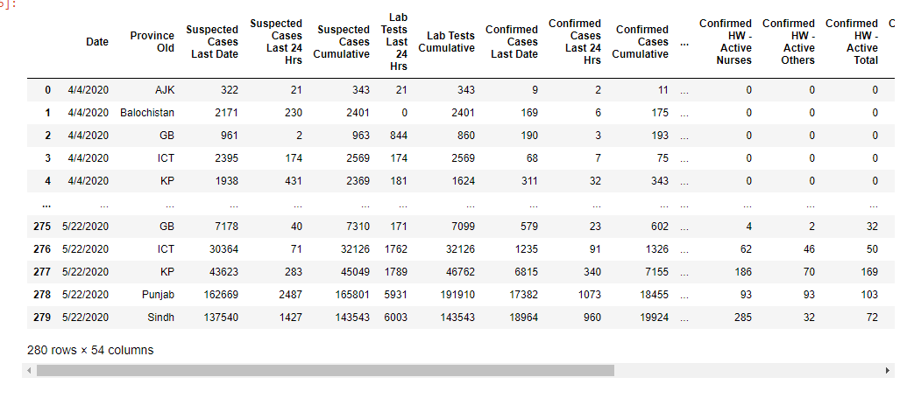
Data After Preparation

Slide 7
Data Exploration
Plotted Graphs to see trends
Trends for positive cases, suspected new cases and deaths
Visualized the impacts of trends
Gave us a useful insight
Infection rate and spread of virus
Analyzing and Predicting Covid-19 Confirmed Cases in Pakistan

Slide 8
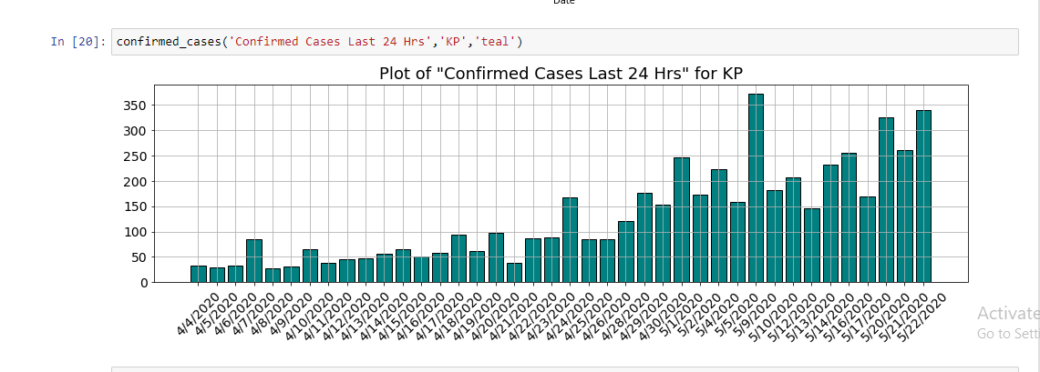
Data Exploration Results

Slide 9
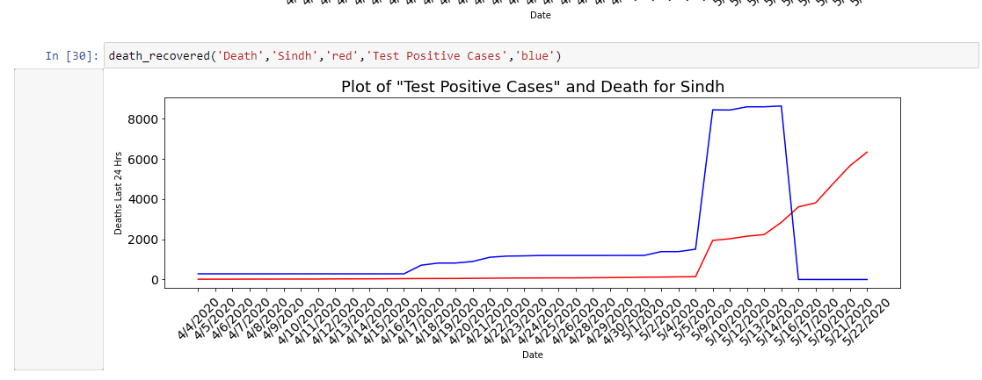
Data Exploration Results

Slide 10
Data Modelling
Decision tree and Naive Bayes
Build Predictive Model
Set the parameters
Split the data
Training data 70 percent
Test data is 30 percent
Analyzing and Predicting Covid-19 Confirmed Cases in Pakistan

Slide 11
Model Output
To Predict Positive cases in upcoming 10 days
After 10 days how many people will be infected
Ratio of people infected by the virus in Punjab and KPK
Analyzing and Predicting Covid-19 Confirmed Cases in Pakistan

Slide 12
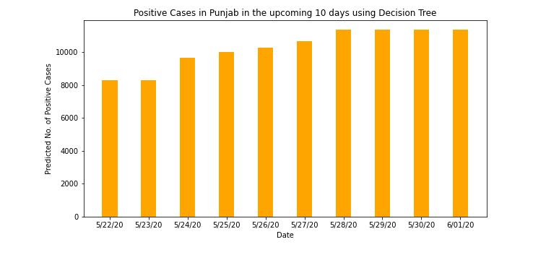
Data Modeling Results

Slide 13
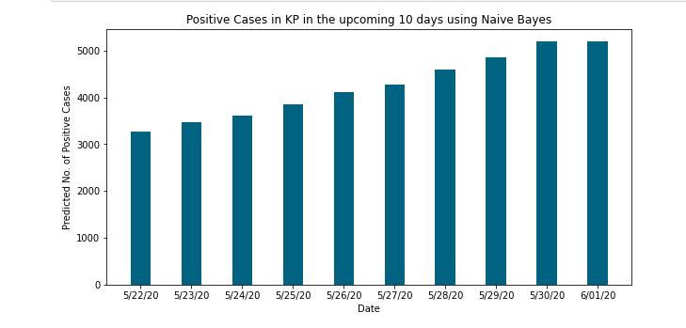
Data Modeling Results

Slide 14
References
https://www.opendata.com.pk/
https://scikit-learn.org/stable
Analyzing and Predicting Covid-19 Confirmed Cases in Pakistan

Slide 15
Thank you!

